Slide 1
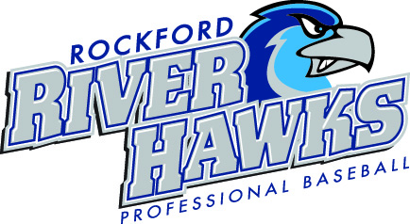
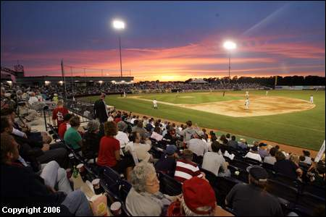
Rockford RiverHawks 2009 Recap
The RiverHawks drew more than 100,000 fans for the sixth year in a row.
The RiverHawks sold out a quarter of their home games, including a crowd of 5,677, for the July 2 game.
Hosted the 2009 Frontier League All-Star Game, Home Run Derby & Cubs/White Sox Legends Game. The two-day event drew more than 5,500 fans.
Jason James hit in a league-record 40 straight games, won the league batting title and signed with the Chicago Cubs.
Announced their move to the independent Northern League for 2010.
Once again providing Northern Illinois and Southern Wisconsin THE BEST AFFORDABLE FAMILY FUN ENTERTAINMENT!!!!!

Slide 2

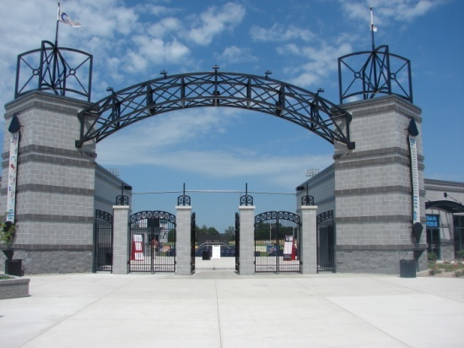
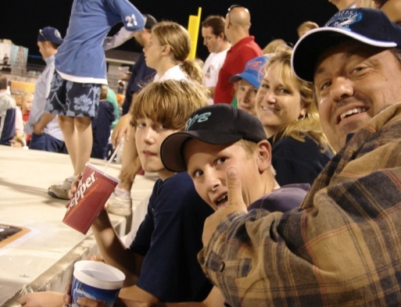
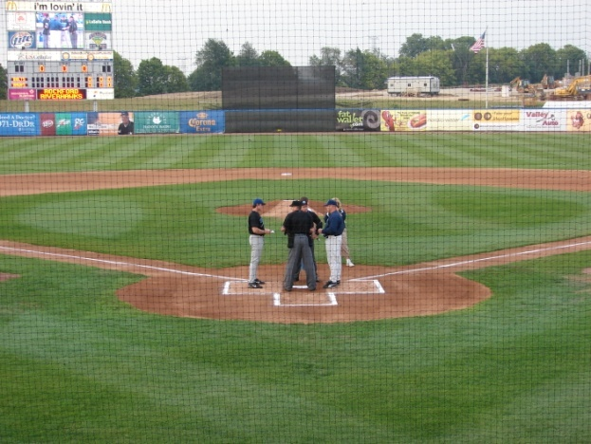
Road Ranger Stadium
The Rockford RiverHawks play in the premier sports complex in Northern Illinois
The new stadium has a seating capacity of 3,279 including suites, terrace boxes, and picnic areas.
The stadium features
  State-of-the-art scoreboard with full video capabilities.
  Every seat is a full box seat, with chairbacks, armrests and cupholders.
  Wide, open-air concourses.
  Team souvenir store
  Children’s play area
  Beach Club Grill with a 300-person capacity
  Voted Rockford’s best concessions by readers of Rockford Register Star
The entrance to the facility is less than ¼ mile from the Riverside exit on 1-90.
The field itself is visible from 1-90.

Slide 3
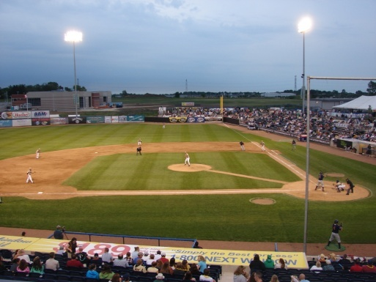
Exposure in 2010
The Rockford RiverHawks, Road Ranger Stadium and Events in 2010.
  Rockford RiverHawks (50) games
  Home to Rockford College Baseball
  IHSA Super Sectionals A, AA
  NAC Conference Tournament
  High School Tournaments
  CVB Outside events (Car Shows)
  Taste of Rockford
  Concerts and more………
  More than 200,000 VISITORS IN 2009!!

Slide 4

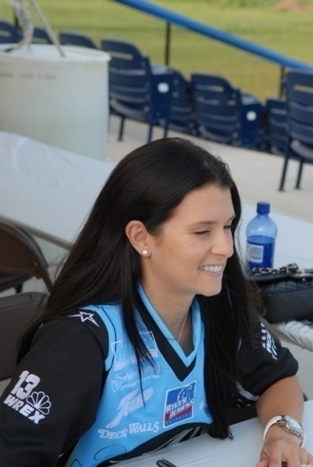
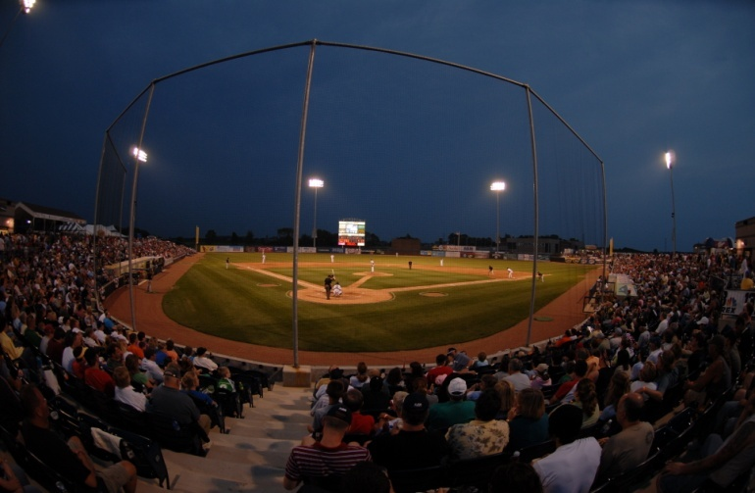
Rockford RiverHawks
The RiverHawks hosted more than 200 games in 2009. In addition to their games, the RiverHawks hosted Rockford College’s entire home schedule, NCAA postseason baseball, a high-school supersectional and many other amateur tournaments. About 200,000 total fans watched games at the stadium in 2009.
The RiverHawks are members of the Northern League, the first modern independent professional baseball league. Member teams include Schaumburg, Joliet, Gary, Lake County (Zion), Kansas City, Fargo and Winnipeg.
The RiverHawks average more than 2,700 fans per game.

Slide 5
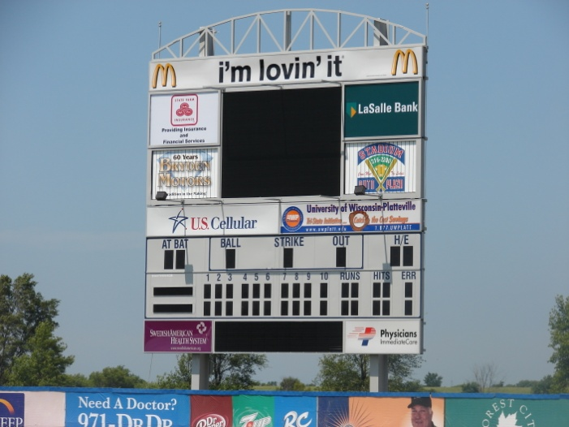
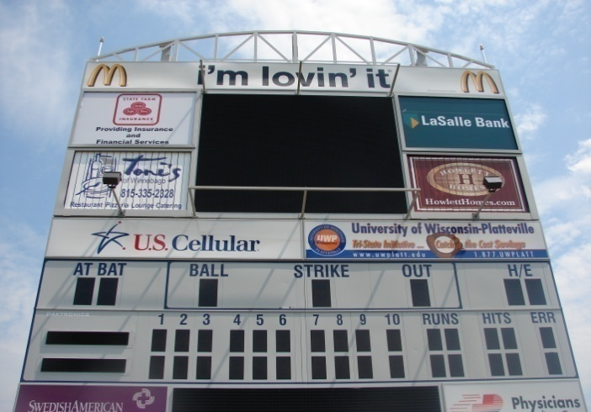
Stadium Scoreboard
Scoreboard Elements
The scoreboard is approximately 42’ h x 39’ w.
Top Scoreboard ad panel (4’ h x 36’ w).
Two (2) upper backlit side ad panels (6’6” h x 9’6” w).
Two (2) tri-vision ad panels (6’6’ h x 9’6” w) three ad panels total per sign.
Two (2) middle backlit panels (3’6” h x 18’ w)
Two (2) bottom backlit panels (3’9” x 10’)
The video board has replay and live video capabilities.
Thirty-second commercial spot each home game.
Multi-year agreement required for scoreboard signage.

Slide 6
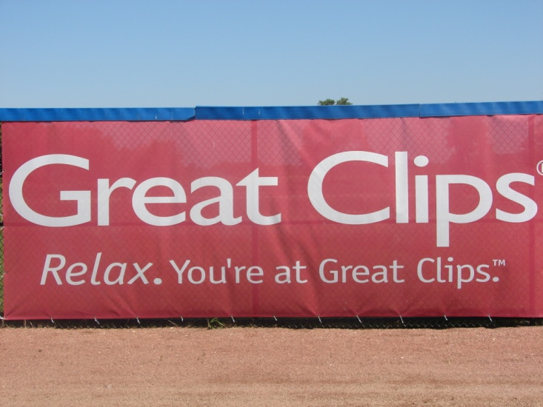
Business Partnerships
Signage
Outfield signs (7.5’ x 20’)
Dugout tops (size varies)
Concourse signs (size varies)
Section Sponsors
Gameday info signs
Signage features:
Full-color art
High-profile exposure
Production/maintenance costs included
In addition to RiverHawks games, your sign is seen at other stadium events. More than 200,000 entered the stadium in 2009.

Slide 7

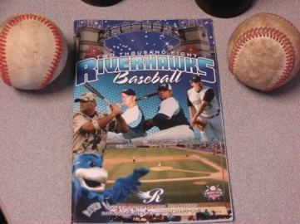
Business Partnerships
Radio Game Broadcasts
The RiverHawks’ radio home is ESPN 1380.
You’ll receive a full minute of advertising (2-:30 or 1-:60) each broadcast, all summer long.
If you don’t have a spot produced, we’ll do the work for you at no extra charge. Voiceover, music bed and sound effects, if desired, give you a professional sound on the air.
Live drops available
Print
Advertising in the RiverHawks Souvenir Program (more than 40,000 distribution).
Ad panels on pocket schedules (200,000).
Full back panel on ticketbacks.
Advertising in scorecard/stat insert

Slide 8
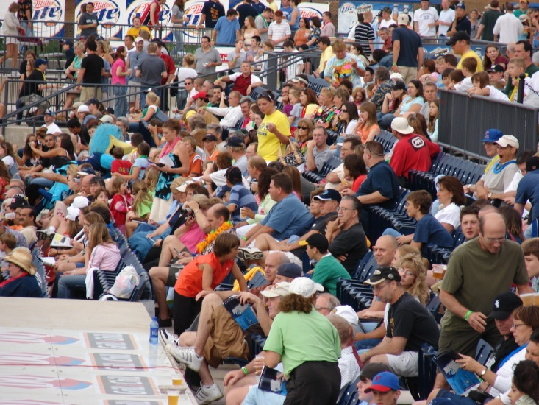
Business Partnerships
Public Address Announcements
•Live PA mentions are a great way to actively promote your business in front of a packed house. Everybody hears a PA drop!
•Available PA drops include scheduled nightly announcements, such as inning sponsorships (1 announcement each game) or situational drops, such as “Call to the Bullpen”, Home Run, etc. that occur whenever that situation happens during the game.
Website
•The team website is the primary source for fans to read up-to-date information on team news, roster moves, statistics, schedule information and promotions. Our website has recorded 2 million hits per month during each of the last two seasons. Site traffic increased by more than 50 percent in 2009.
•You will receive a live ad link on our website. Visitors who click on your logo graphic will go directly to your website.

Slide 9
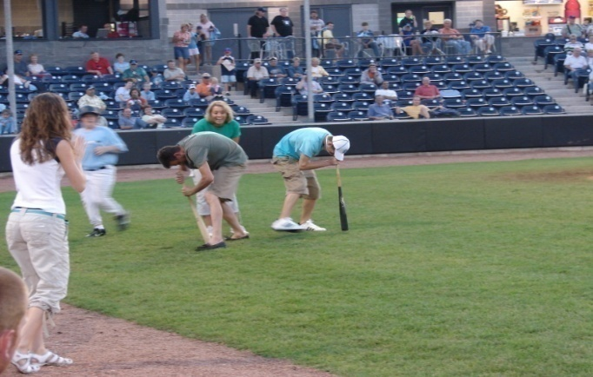
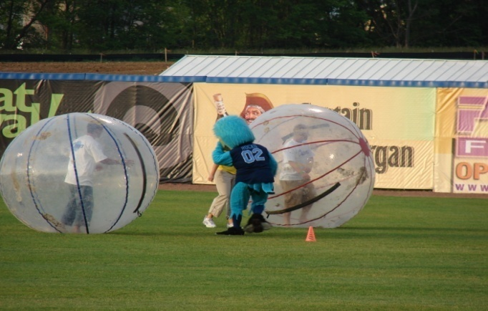
On Field Promotions
Fans tell us in annual surveys that our zany on-field promotions are one of their favorite parts of the ballpark experience.
Each winner will receive a great prize, provided by you, that will drive business to your door.
Your on-field promotion will run every other home game, 25 times in all.
Dizzy Bat Race
Dice Toss
Mascot Race
Chicken Toss
Mascot Sponsorship
T Shirt Toss
Sumo Wrestling
Hamster Ball Race
And much more!!!

Slide 10
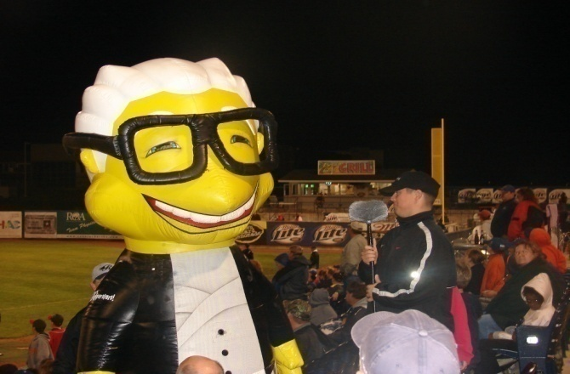
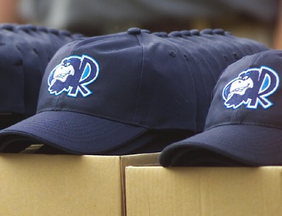
Business Partnerships
Promotional Nights
Fans stream into the ballpark for our premium giveaway nights. Planned giveaway items include caps, t-shirts, baseball cards, bobbleheads, etc.
Other promotional nights include: Fireworks Nights, Diamond Dig, Used Car Giveaways; touring entertainers such as the Zooperstars.
The RiverHawks will meet or exceed your investment in media advertising to ensure your night’s success. (television ads, radio spots on all seven of our local stations, live drops on team radio broadcasts, PA drops, website).
Sponsor has unique exposure on the giveaway night (tabling, ceremonial first pitch, seventh-inning stretch)

Slide 11
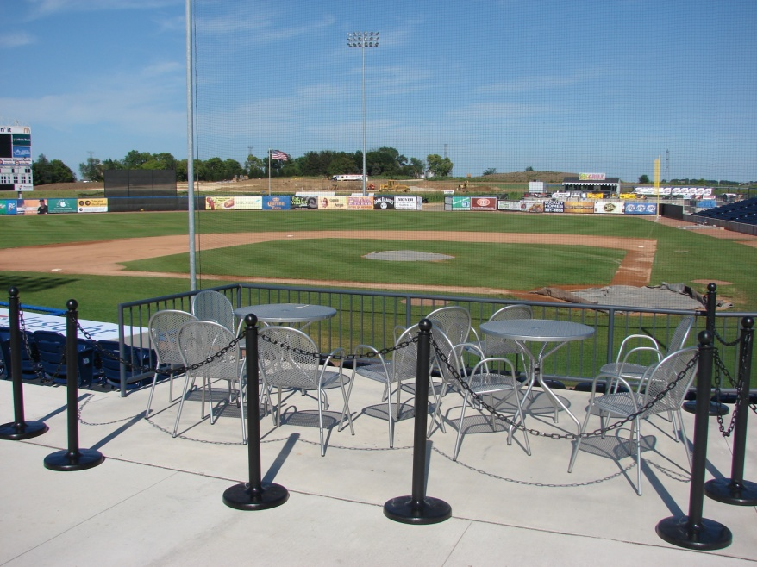
VIP Hospitality
Terrace Box
Our Terrace Box Suites are the premium seats in the stadium. Each Terrace Box Suite includes seating for 10 around a pair of bistro tables.
Theatre-style stanchions and chains separate your Terrace Box from the concourse and limit entry.
You receive two free parking passes.
Waitress service available for your food/drink orders.
You have exclusive access to this seat for all 50 regular-season home games. Terrace Box holders also have first right of refusal to purchase Terrace Box for other stadium events.

